Slide 1
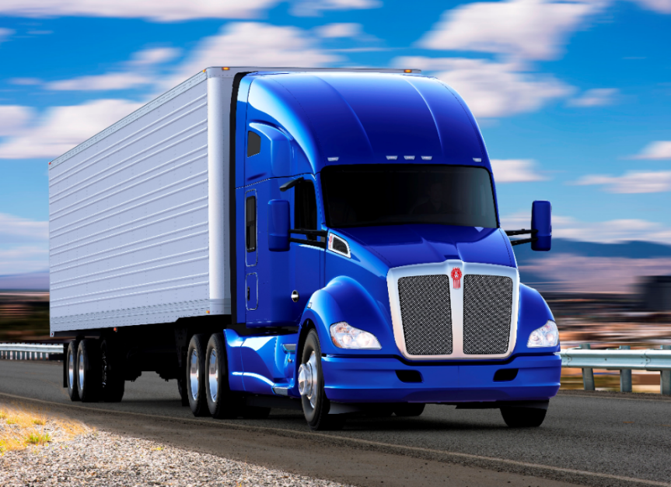
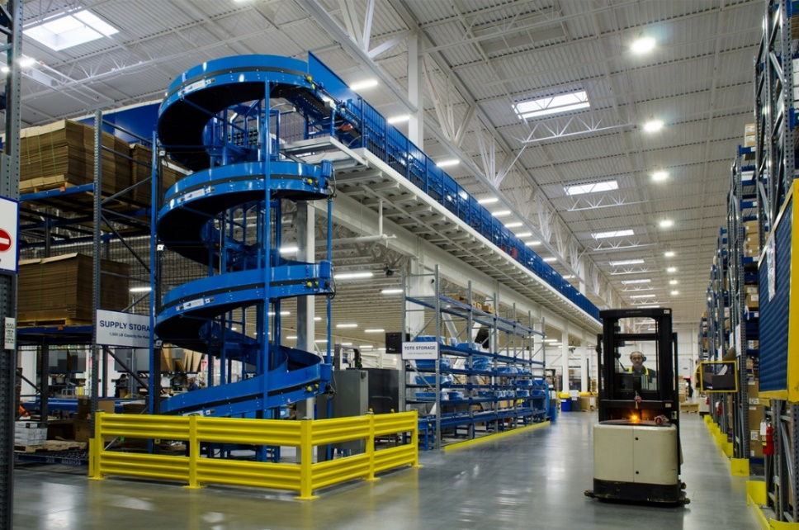

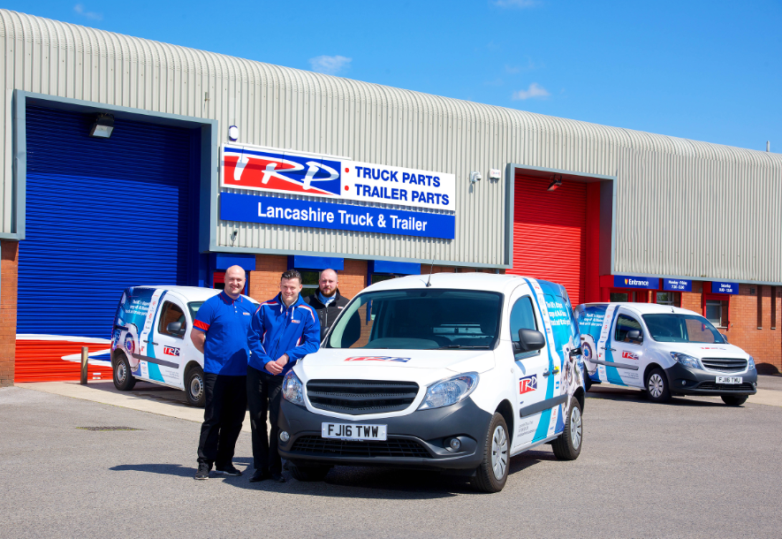
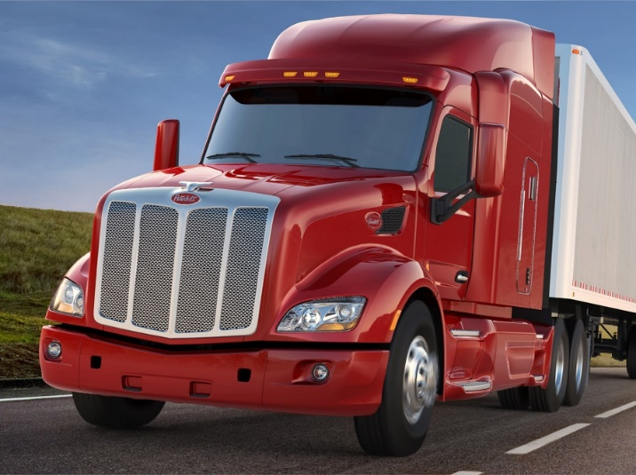
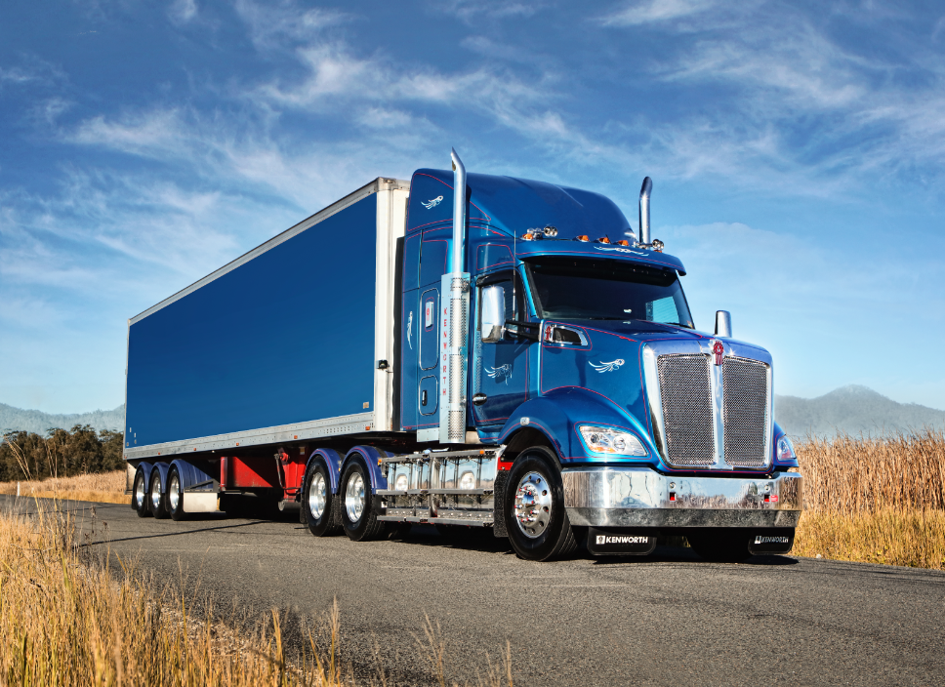
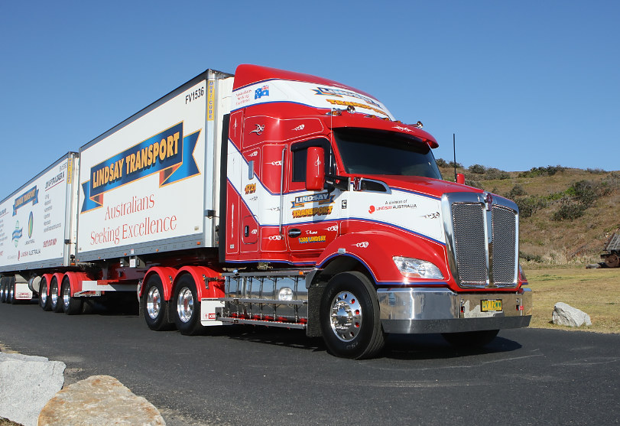

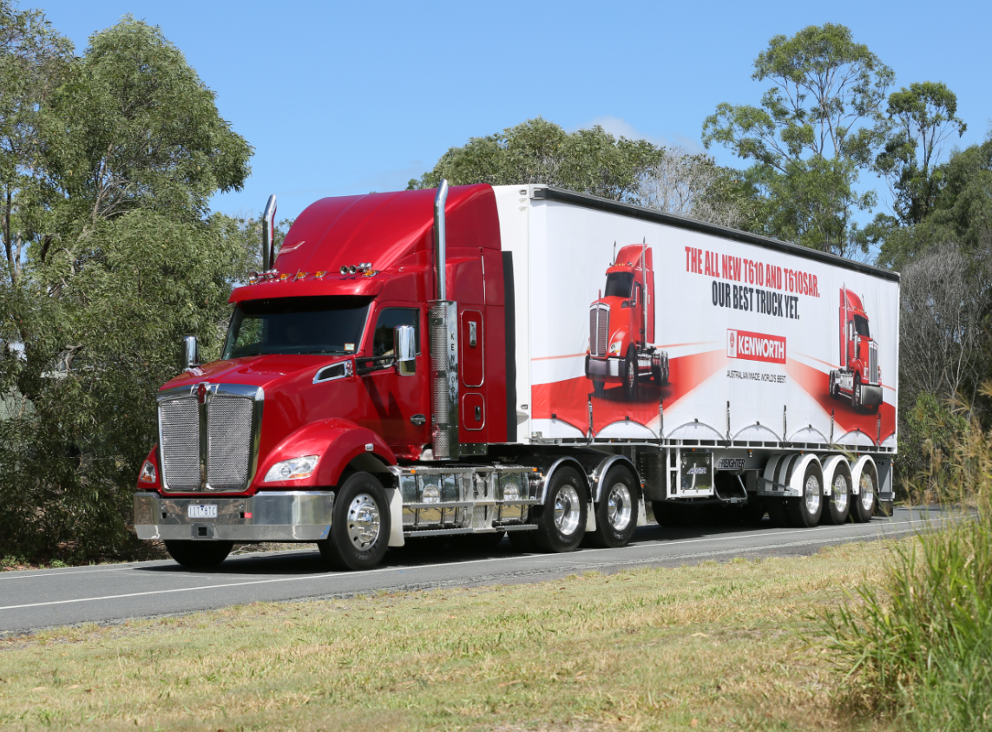
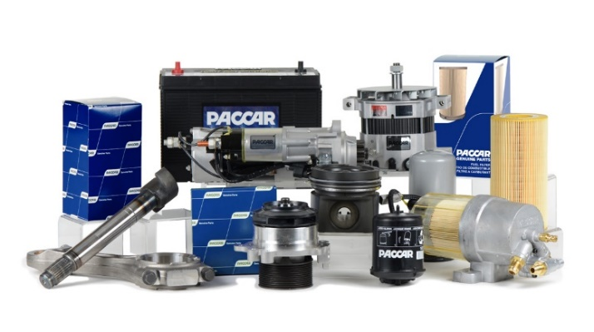

Slide 2

Seattle University Data Analytics
5/16/ 2018

Slide 3
Tonight's Objectives
Introductions
Transportation and Logistics
PACCAR Overview
My Leadership Journey Using Data
Gain Insight on Supply Chain Challenges
Learn the Day in the Life of PACCAR Parts Materials Data Analyst
Solve a Complex PACCAR Problem
Review Data for Next Weeks Class

Slide 4

PACCAR Team Introductions
Brett Durfee, Director Application Delivery
Aaron McDaniel, Data Analyst Materials
Brian Julius, Manager Materials
Baylee Hamilton, Data Analyst Materials
Rylee Iacolucci, Materials Data Analyst

Slide 5
Class Assignment
Project and Summary: You are part group of data analysts who work for the PACCAR Parts Materials team, an aftermarket planning team which manages the dealer parts inventory for PACCAR products used in vehicles (brands: Kenworth, Peterbilt and DAF) globally. As a group of data analysts, your jobs are to ensure that all dealer globally have parts inventory on hand to service the vehicle. If the dealership doesn’t have the part in inventory the part has to be delivered within hours to the Dealer using a centralized distribution network. Since all dealers are independently owned, a dealer may sell other trucks products, aftermarket parts and services for competing brands (e.g. Volvo, Mack, Toyota, Mercedes, Tesla, etc.). There are some common parts that are shared across all brands of vehicles (air filters, lubricants, nuts, bolts, etc.). In addition, the same suppliers used to support the aftermarket are also used in manufacturing new products.
During an economic slowdown which typically increases the demand for aftermarket parts, you establish an improvement process in managing the supply chain and improve your distribution center fill rate. You recently were notified that PACCAR manufacturing build rates are increasing and you want to maintain the improvements in the distribution chain process that you and your team achieved during an economic slowdown. Your job is to use a common set of data to determine options for maintaining a complex network and maintaining or improving fill rates as the manufacturing teams increase vehicle production.

Slide 6
Class Assignment
Project and Summary: You are part group of data analysts who work for the PACCAR Parts Materials team, an aftermarket planning team which manages the dealer parts inventory for PACCAR products used in vehicles (brands: Kenworth, Peterbilt and DAF) globally. As a group of data analysts, your jobs are to ensure that all dealer globally have parts inventory on hand to service the vehicle. If the dealership doesn’t have the part in inventory the part has to be delivered within hours to the Dealer using a centralized distribution network. Since all dealers are independently owned, a dealer may sell other trucks products, aftermarket parts and services for competing brands (e.g. Volvo, Mack, Toyota, Mercedes, Tesla, etc.). There are some common parts that are shared across all brands of vehicles (air filters, lubricants, nuts, bolts, etc.). In addition, the same suppliers used to support the aftermarket are also used in manufacturing new products.
During an economic slowdown which typically increases the demand for aftermarket parts, you establish an improvement process in managing the supply chain and improve your distribution center fill rate. You recently were notified that PACCAR manufacturing build rates are increasing and you want to maintain the improvements in the distribution chain process that you and your team achieved during an economic slowdown. Your job is to use a common set of data to determine options for maintaining a complex network and maintaining or improving fill rates as the manufacturing teams increase vehicle production.

Slide 7
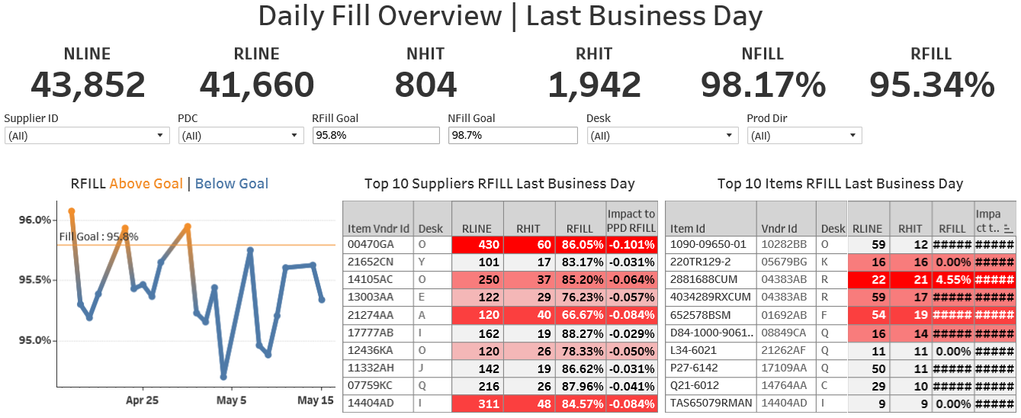
PACCAR Parts Materials Data
Data Management
Cleaning
Archiving
Accessibility
Report Visualization
Data Analysis

Slide 8
Class Assignment
What is the current state? External Factors? Internal Performance
How can the data be categorized?
What data models or analytical tools can you implement for short and long term solutions? Additional external data?
What actions should be taken? How do you prioritize first steps?
What recommendations would you make to Management?
What are the impacts of your proposal on Fill Rates and other areas of the business?

Slide 9

Class Assignment
Viable Business Solutions
State Assumptions
Explain Math/Logic
Ask Questions

